Slide 1

Introduction to Machine Learning
From raw data to predictive models
Yordan Darakchiev
Technical Trainer
iordan93@gmail.com

Slide 2
sli.do #MachineLearning

Slide 3
Table of Contents
The scientific method – overview
Knowledge discovery from data
Machine learning
Basic concepts
Algorithms (models) overview
Getting, preparing and exploring data
Review
Machine learning process overview

Slide 4
The Scientific Method
How to work with data… the right way

Slide 5
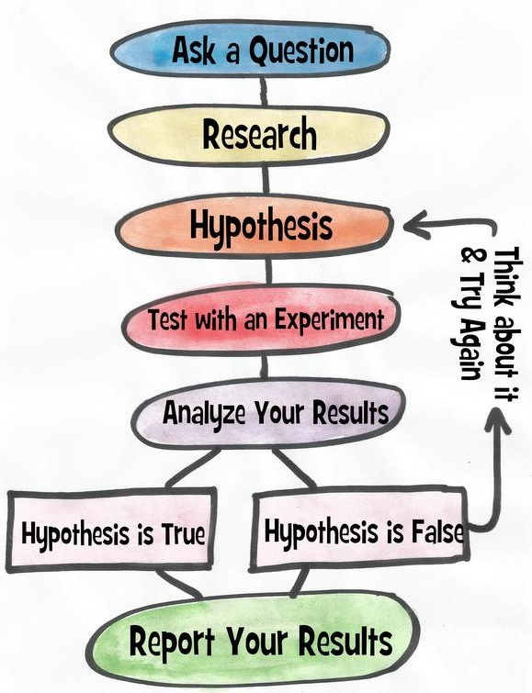

The Scientific Method Steps
Ask a question
Do a research
Form a hypothesis
Test the hypothesis with an experiment
Experiment works $⇒$ Analyze the data
Experiment doesn't work $⇒$ Fix experiment
Results align with hypothesis $⇒$ OK
Results don't align with hypothesis $⇒$ new question, new hypothesis
Communicate the results

Slide 6
OSEMN Model
Some guidelines on the process to extract meaningful information from data
Very similar to the scientific method
Can be viewed as a sequential process
Or just as some guidelines on how to do research
Read as "awesome"
Obtain data
Scrub data
Explore data
Model data
iNterpret the results

Slide 7

Applied Machine Learning Process
This allows us to do our job faster and more reliably
Problem definition
Make sure the problem is well-defined and that you're solving the right problem
Data analysis
Get familiar with the available data
Data preparation
Get the data ready for modelling
Algorithm evaluation
Test and compare algorithms
Result improvement
Use results to create better models (e.g. fine-tuning, ensembles)
Result presentation
Describe the problem and solution to non-specialists

Slide 8
Machine Learning
Fundamental concepts

Slide 9
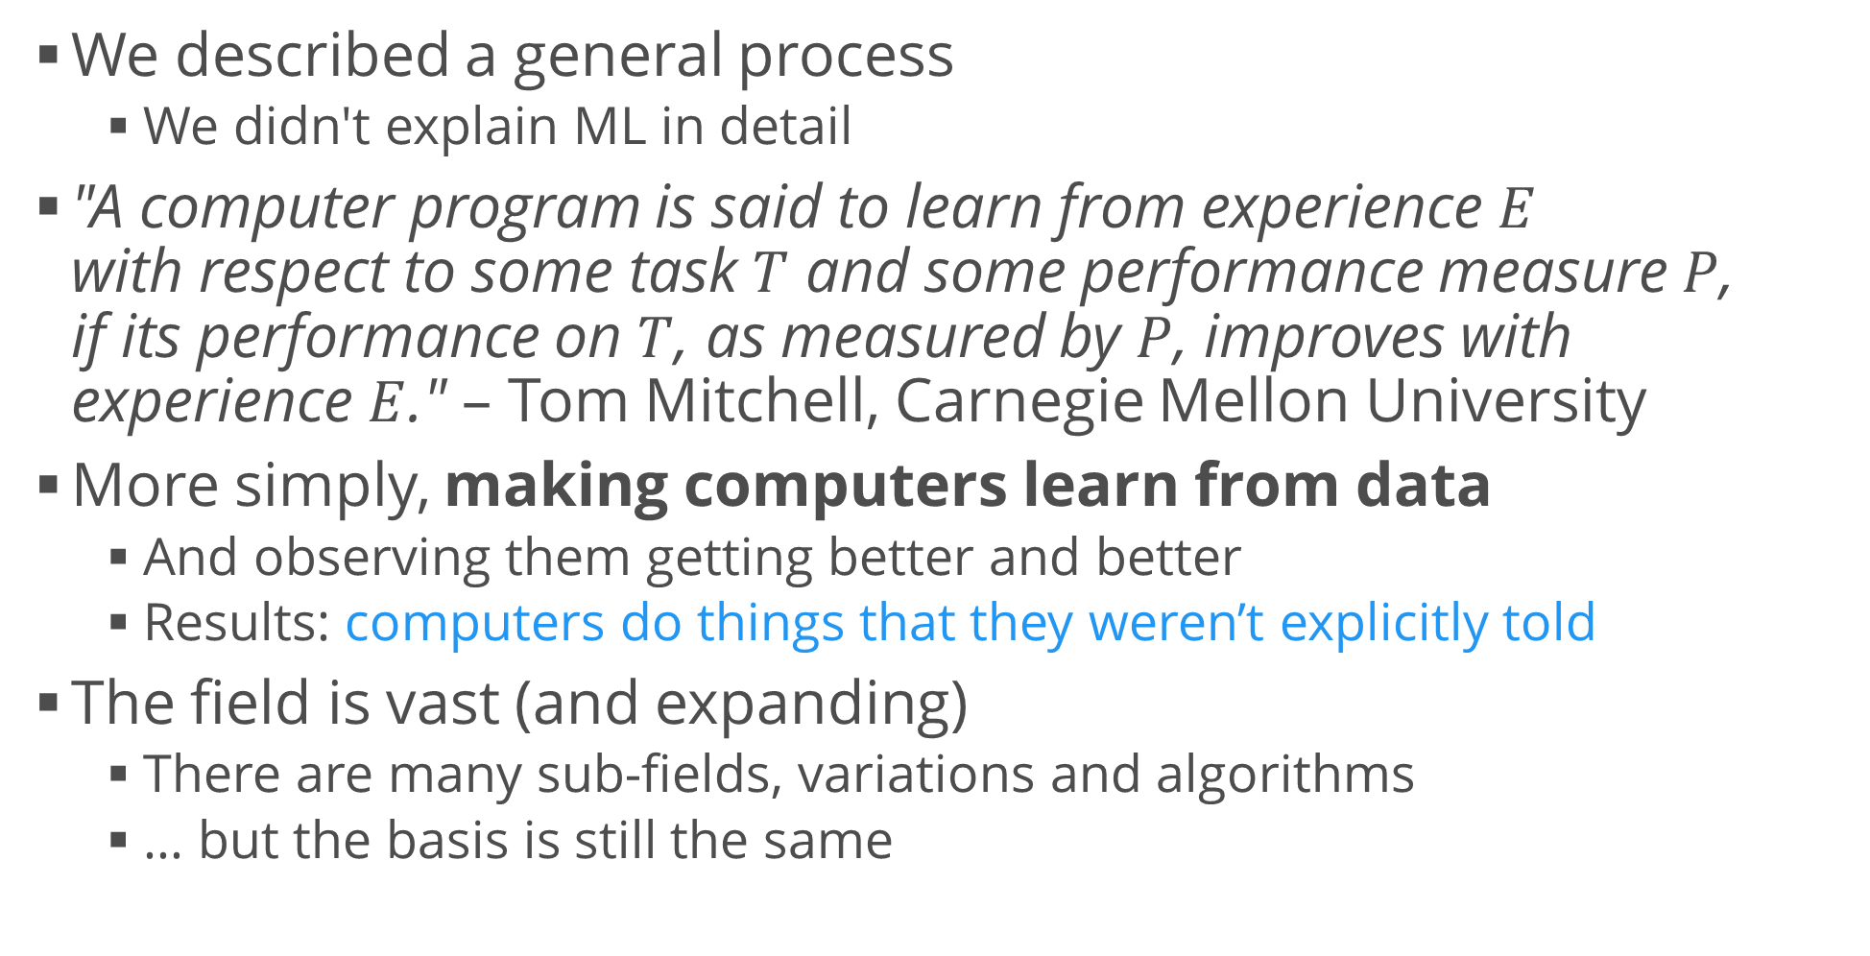
Machine Learning
We described a general process
We didn't explain ML in detail
"A computer program is said to learn from experience $E$ with respect to some task $T$ and some performance measure $P$, if its performance on $T$, as measured by $P$, improves with experience $E$." – Tom Mitchell, Carnegie Mellon University
More simply, making computers learn from data
And observing them getting better and better
Results: computers do things that they weren’t explicitly told
The field is vast (and expanding)
There are many sub-fields, variations and algorithms
… but the basis is still the same

Slide 10
Types of Machine Learning Algorithms
Supervised learning
We train the program on previously known (labelled) data
After training, we expect it to make predictions on new data
Examples: regression, classification
Unsupervised learning
We leave the program to find patterns in data
Examples: clustering analysis, dimensionality reduction
Reinforcement learning
A form of unsupervised learning
The program learns continuously
Examples: learning to play a game by observing other players, learning to drive a car

Slide 11
Algorithms by Task
Statistical algorithms
Regression – predicting a continuous variable
Classification – predicting class labels
Clustering – finding compact groups of data points
Dimensionality reduction – simplifying the input data
Recommendation – suggest items for users
Optimization – minimize / maximize a target function
Testing and improvement algorithms – helper algorithms to select, fine-tune and optimize other ML algorithms
… and more :)

Slide 12
Getting and Preparing Data
Review: Preparing raw data for modelling

Slide 13
Common Libraries
In Python, we use libraries to perform common operations
scikit-learn – machine learning models
pandas – working with data
Reading, tidying, cleaning, preparation
numpy and scipy – numerical and scientific libraries
Contain a ton of useful functions for performing research
matplotlib – plotting and data visualization
There are many more we'd like to use but these are the most commonly used ones

Slide 14
Getting and Preparing Data
10 Minutes to pandas
Pandas Cheat Sheet
Full docs
Tidy up the data
Preprocess the data w.r.t. the task at hand
Explore the data
Exploratory data analysis
Don't forget to make graphs
Create meaningful features
Feature {selection, extraction, engineering}
Example: Titanic dataset

Slide 15
Example: Preparing Data for Modelling
Most models require two additional steps
Convert categorical variables into indicator variables
Normalize values if needed (e.g. scale all variables from 0 to 1 using min-max scaling, or use Z-scores)
Perform other model-specific transformations
E.g. your model may not work well with highly imbalanced data (when you look for anomalies)
If possible, prepare several versions of the dataset
To see how a transformation affects model performance
Describe and document the entire process!
Don't forget the rules for reproducible research
dataset = pd.get_dummies(dataset)

Slide 16
Example: AzureML
In this course, we'll be using Python code to run and evaluate models
We'll create a nice, structured pipeline
But there are other solutions
Microsoft AzureML Studio: https://studio.azureml.net/
Good for a demo if you’re not experienced in coding
Pros
Free to try
Easy, visual representation of the workflow
Has many predefined modules; can also execute Python code
Runs on the cloud – no need to throttle your machine
Cons
Hides away or obscures some important implementation details
Running on the cloud is too expensive sometimes

Slide 17
Summary
The scientific method – overview
Knowledge discovery from data
Machine learning
Basic concepts
Algorithms (models) overview
Getting, preparing and exploring data
Review
Machine learning process overview

